Slide 1
Analysis of gas compounds by absorbance spectrum
By Olav Grouwstra

Slide 2
Overview
From gas to absorbance spectrum
Setup
Theory
Absorbance spectrum
Spectrum calibration
Wavenumber calibration
H₂O and CO₂ calibration
Healthy vs. Asthmatic
Concentration analysis
Notes:
From gas to spectrum.; From ill fitting spectrum to better fitting spectrum

Slide 3
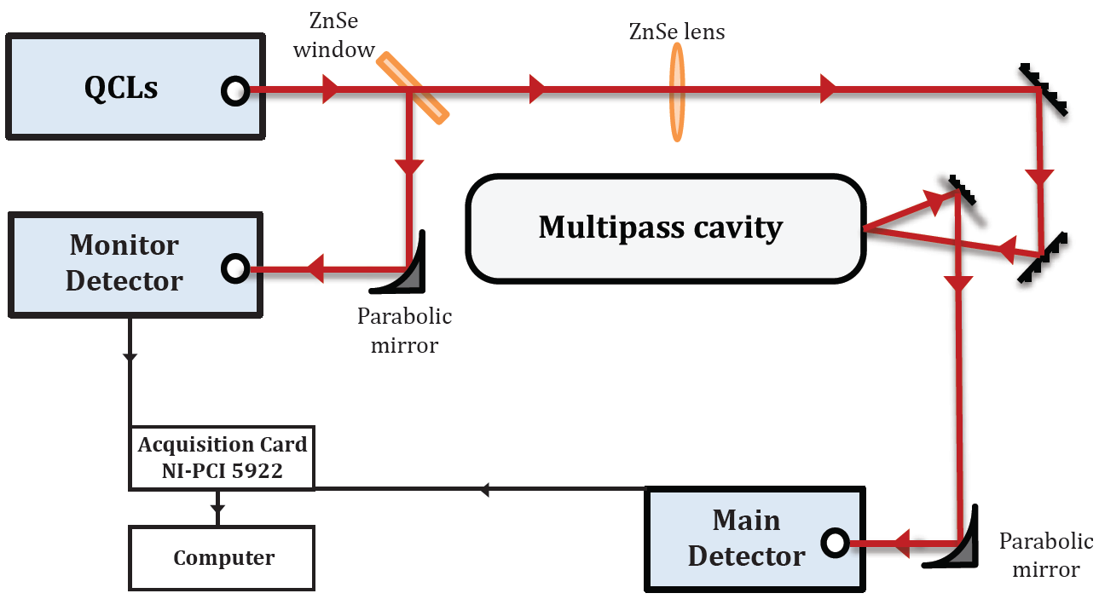




Setup
 | Gas measurement | Reference
Main detector
Monitor detector
$$I_{QCL}\left(ν\right)f_{path1}f_{gas}\left(ν\right)$$
$$I_{QCL}\left(ν\right)f_{path1}$$
$$I_{QCL}\left(ν\right)f_{path2}$$
$$I_{QCL}\left(ν\right)f_{path2}$$
Notes:
Gas -> signals
With compliments to Zhe Hou and Adonis for making this!

Slide 4
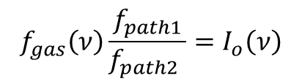



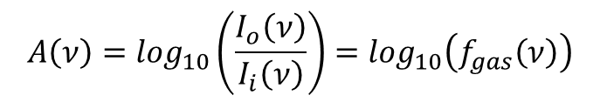

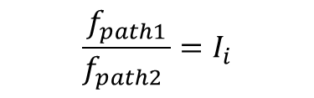
Theory
 | Gas measurement | Reference
Main detector
Monitor detector
$$I_{QCL}\left(ν\right)f_{path1}f_{gas}\left(ν\right)$$
$$I_{QCL}\left(ν\right)f_{path1}$$
$$I_{QCL}\left(ν\right)f_{path2}$$
$$I_{QCL}\left(ν\right)f_{path2}$$
$$f_{gas}\left(ν\right)\frac{f_{path1}}{f_{path2} }=I_{o}\left(ν\right)$$
$$\frac{f_{path1}}{f_{path2} }=I_{i}$$
Beer-Lambert law $I_{o}\left(ν\right)$ = $I_{i}\left(ν\right) {10}^{−A\left(ν\right)}$
$$A\left(ν\right)=\log_{10}\left(\frac{I_{o}\left(ν\right)}{I_{i}\left(ν\right)}\right)=\log_{10}\left(f_{gas}\left(ν\right)\right)$$
Absorbance
Notes:
LEAVE TABLE AS IT IS, INTRODUCING THE v’ to show the different wavenumbers (due to piëzo) makes it too complicated for the presentation.
Signals -> Absorbance

Slide 5
Theory
Absorbance
$$A\left(ν\right)= ε\left(ν\right)cl$$
Molar absorptivity
$$ε\left(ν\right)$$
Concentration
$$c$$
Path length
$$l$$
Notes:
Signals -> Absorbance

Slide 6
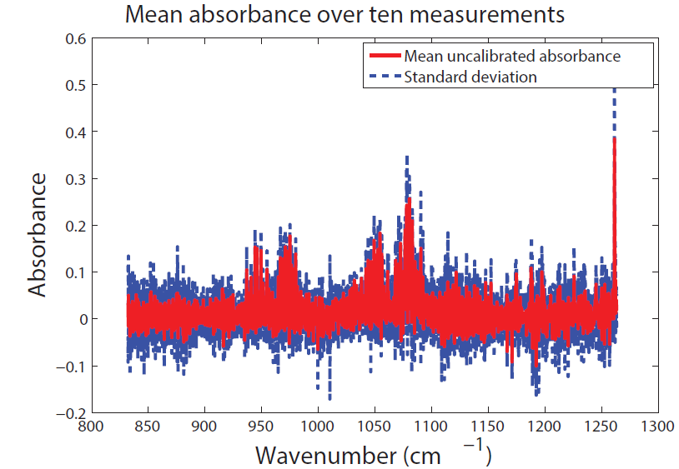
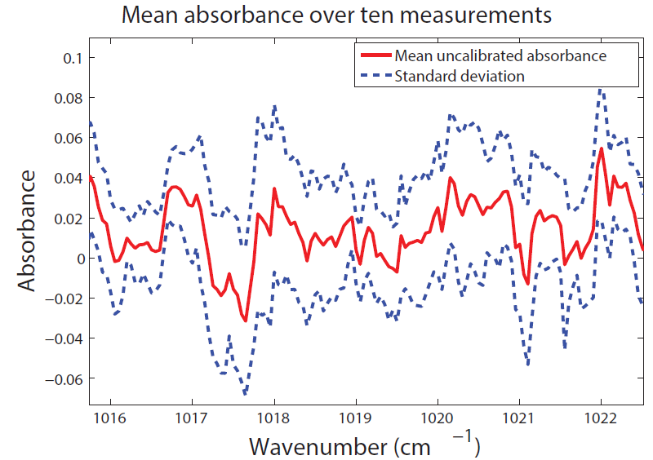
Absorbance spectrum
Notes:
Add slide that shows water+CO2 estimation (using sqnonlin regression), with water+CO2 concentrations overlaid on the spectrum. Show it doesn’t correspond well.

Slide 7
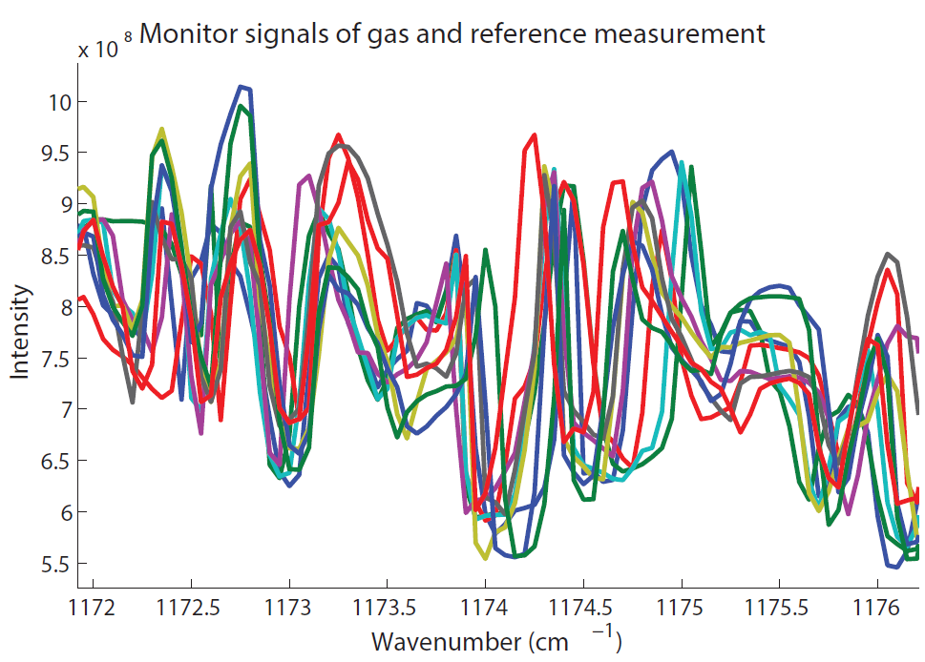
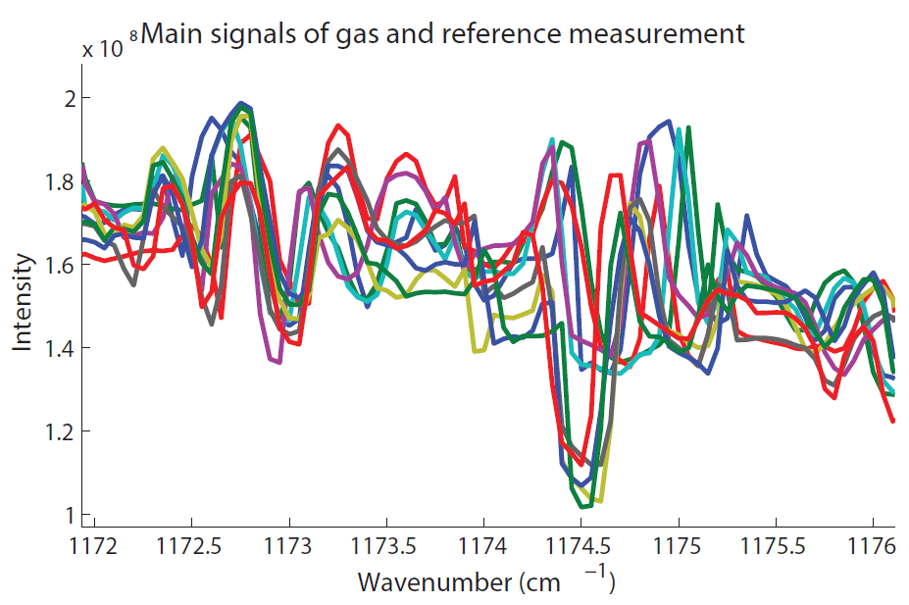

Wavenumber calibration
Notes:
Looking at main and normalisation signals shows wavenumber misalignment among measurements. Since both main and monitor signals of the gas and reference measurement are needed for the absorbance, they should be calibrated toward the same reference. The most obvious reference would be the average of the gas and reference measurements. This works for the monitor signals, but the main signal differs for the gas and reference measurements, and thus the average would not be a clear reference. Used signals 6-15, i.e. the last 5 of gas, and the first 5 of reference.

Slide 8
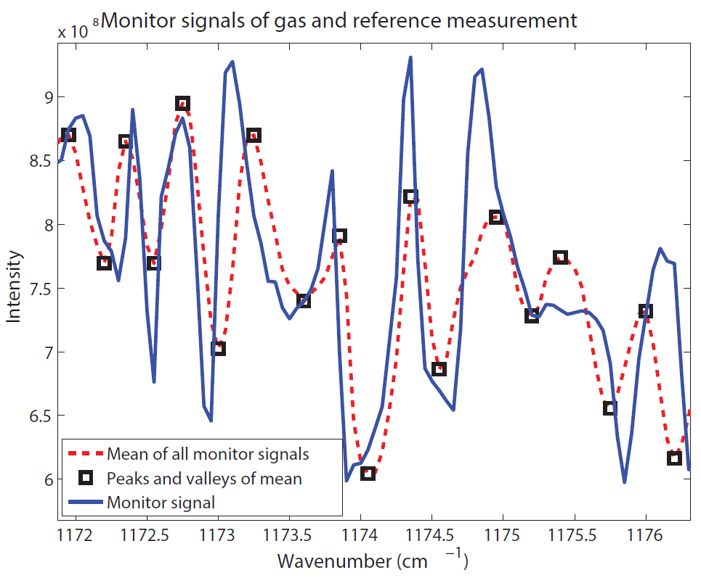
Wavenumber calibration
Notes:
Picture explanation:
1). Pic of two monitor signals and the mean of all signals.
2). Mark peaks and valleys of mean.
3). Mark first and second valley of mean as boundary for finding first peak.
4). Mark first data peaks.
5). Mark second and third valley of mean as boundary for finding second peak.
6). Mark second data peaks.
7). Mark all data peaks and valleys.
The monitor signals are first calibrated toward their average, and then the same transformation is applied to their associated main signals.

Slide 9
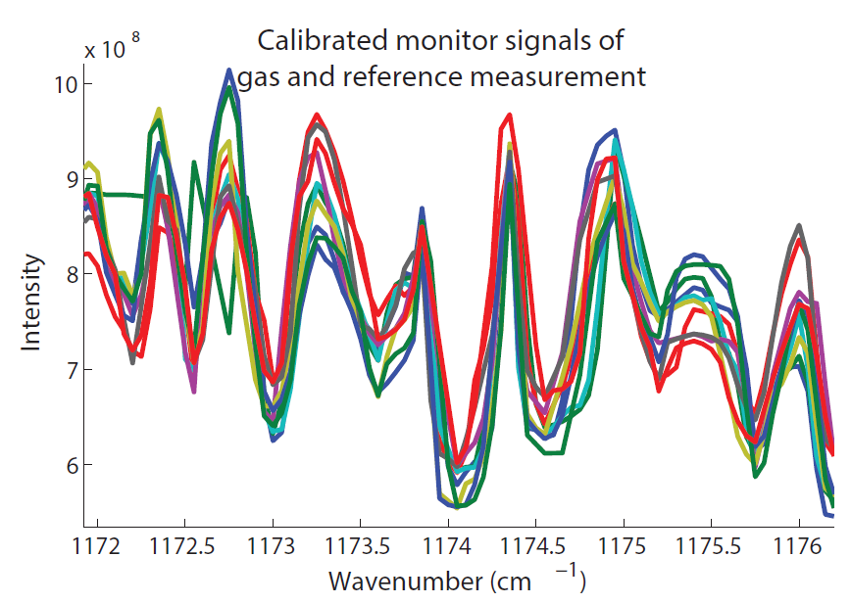
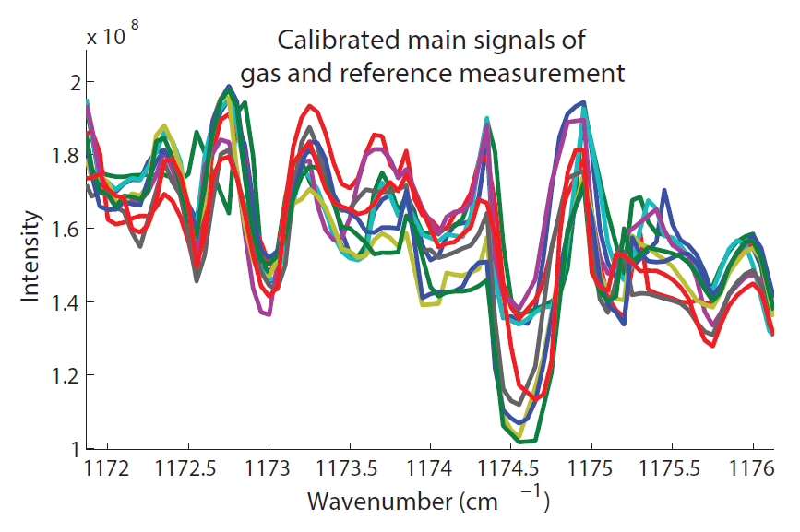
Wavenumber calibration
Notes:
Standard dev. decreased by 19% for the ten monitor signals shown. Due to the use of 20 monitor and 20 main signals and the mathematical operations to get the absorbance, the decrease in st. dev. of the absorbance is only 7%. Water+CO2 estimation overlaid on spectrum does not show a noticeable difference before and after wavenumber calibration. When comparing absorbances before and after calibration, they both look like a mess (as indicated by the low decrease in st. dev.).

Slide 10
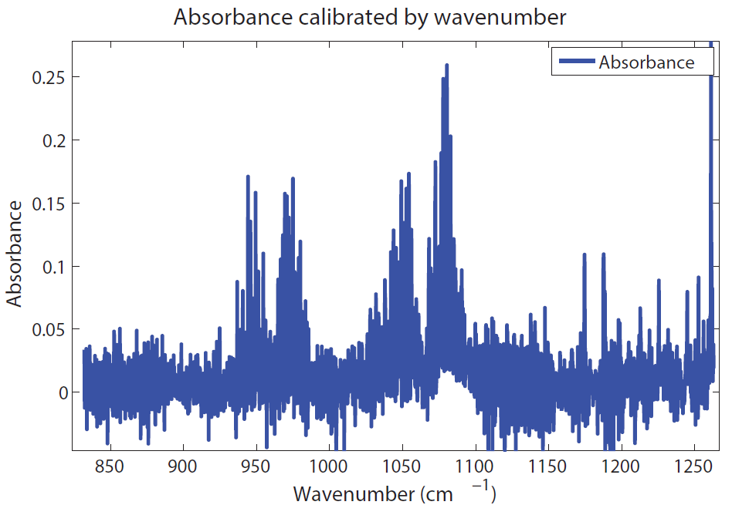
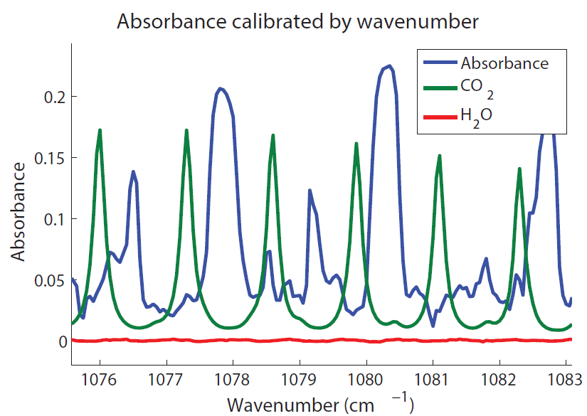
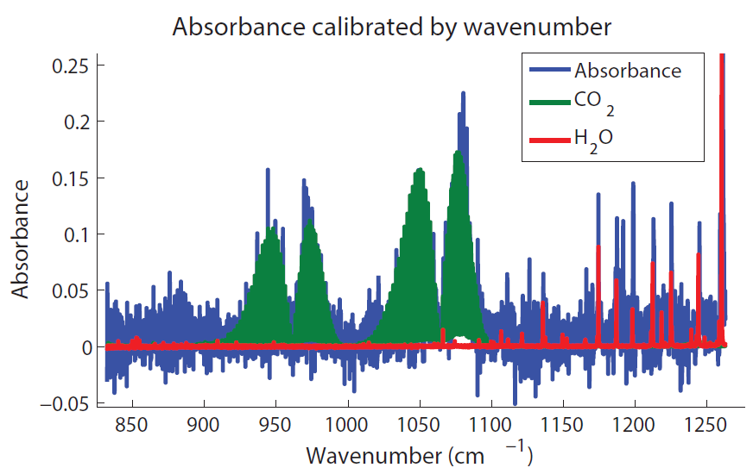
H₂O and CO₂ calibration
CO₂
H₂O

Slide 11
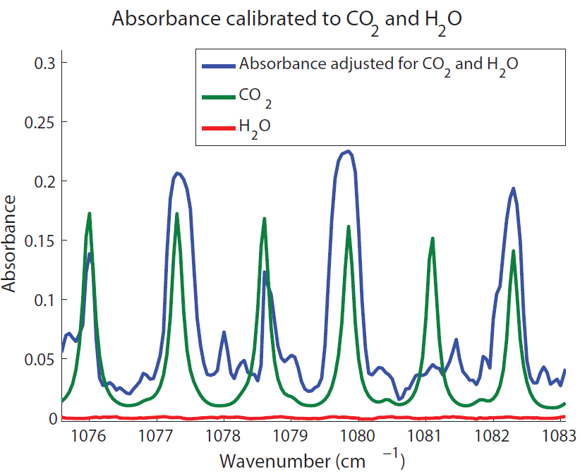
H₂O and CO₂ calibration
Notes:
Laser can skip wavelengths due to the hysteresis of the piëzo, which would explain the missing peak at 1081.5, except that this signal is a mean of 20 measurements, making that quite unlikely.

Slide 12
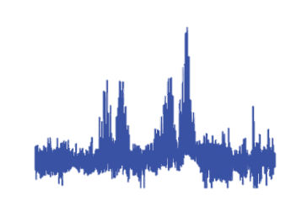
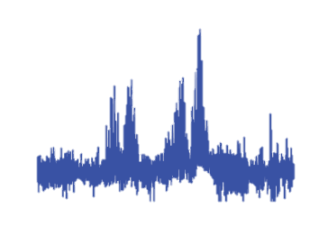

Healthy vs. Asthmatic breath
Healthy
Molecule 32
Molecule 192
Molecule 230
Areas of difference
Molecule 32
Molecule 192
Molecule 230
H₂O
Ethanol
CO₂
…
Asthmatic
Selected absorptivities
Molecule 1
…
Molecule 400
H₂O
CO₂
Ethanol
…
Absorptivities
Database
Absorptivity of 400+ molecules
Absorptivities standard molecules

Slide 13
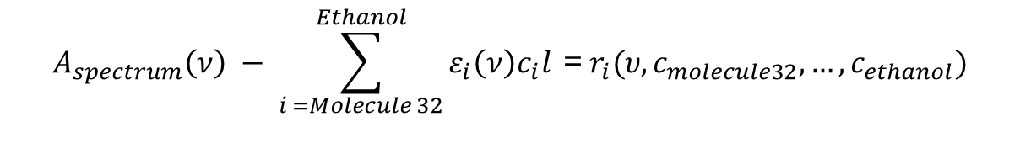
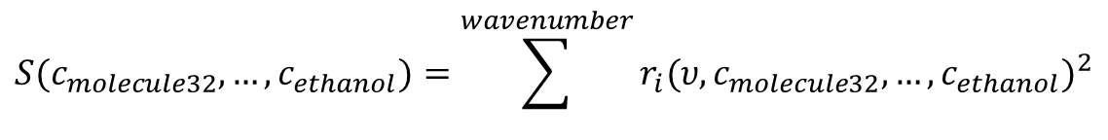
Concentration analysis
$$A_{spectrum}\left(ν\right) − \sum_{i =Molecule 32}^{Ethanol}{ε_{i}\left(ν\right)c_{i}l} \text{=} r_{i}(υ,c_{molecule32},…,c_{ethanol})$$
Molecule 32
Molecule 192
Molecule 230
H₂O
Ethanol
CO₂
…
Absorptivities
$$S(c_{molecule32},…,c_{ethanol})=\sum^{wavenumber}{{r_{i}(υ,c_{molecule32},…,c_{ethanol})}^{2}}$$
Minimise
Notes:
Nonlinear least-squares regression.

Slide 14
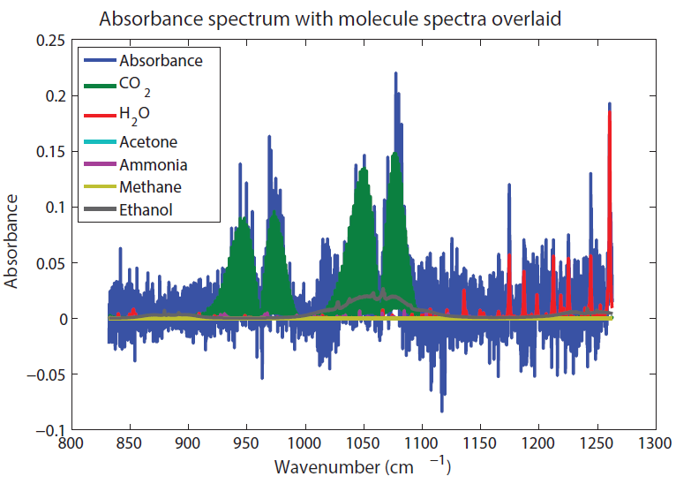
Concentration analysis

Slide 15
Concentration analysis
Notes:
H2O is also filtered when going into the cavity, which could explain the lower than expected measured H2O. The breathing masks of the children are cleaned using ethanol, which is a possible explanation for abnormally high ethanol.

Slide 16
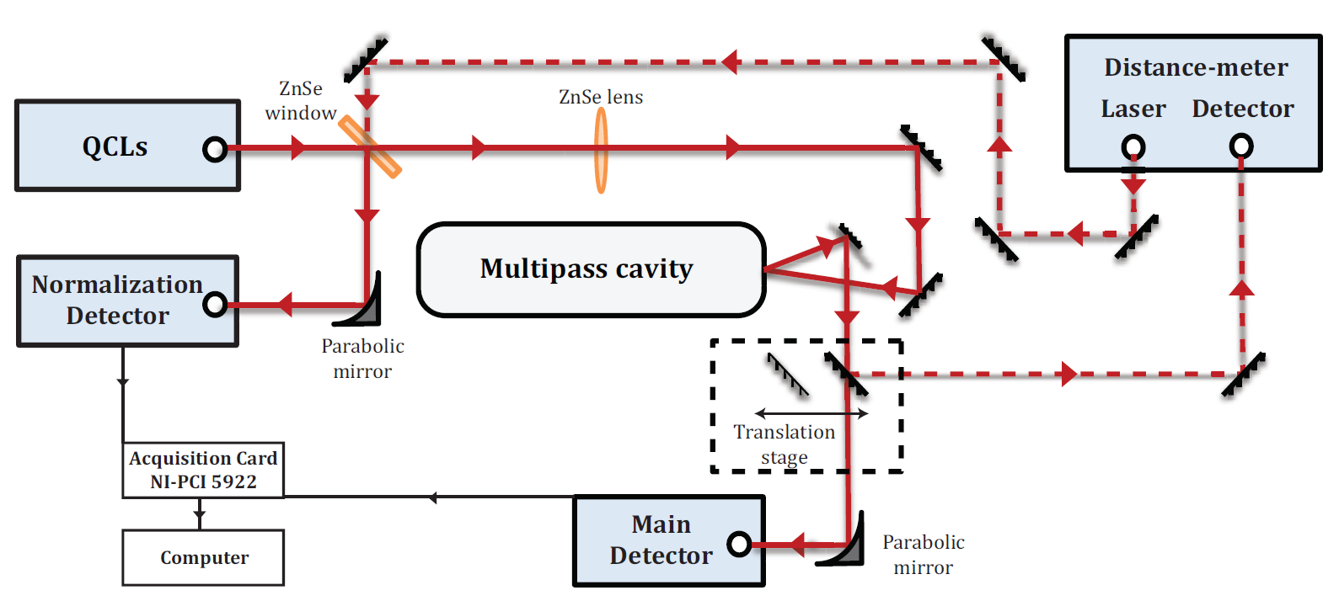

Slide 17









